Slide 1
Computation of matrix functions with fully automatic Schur-Parlett and Rational Krylov methods.
Roberto Zanotto

Slide 2
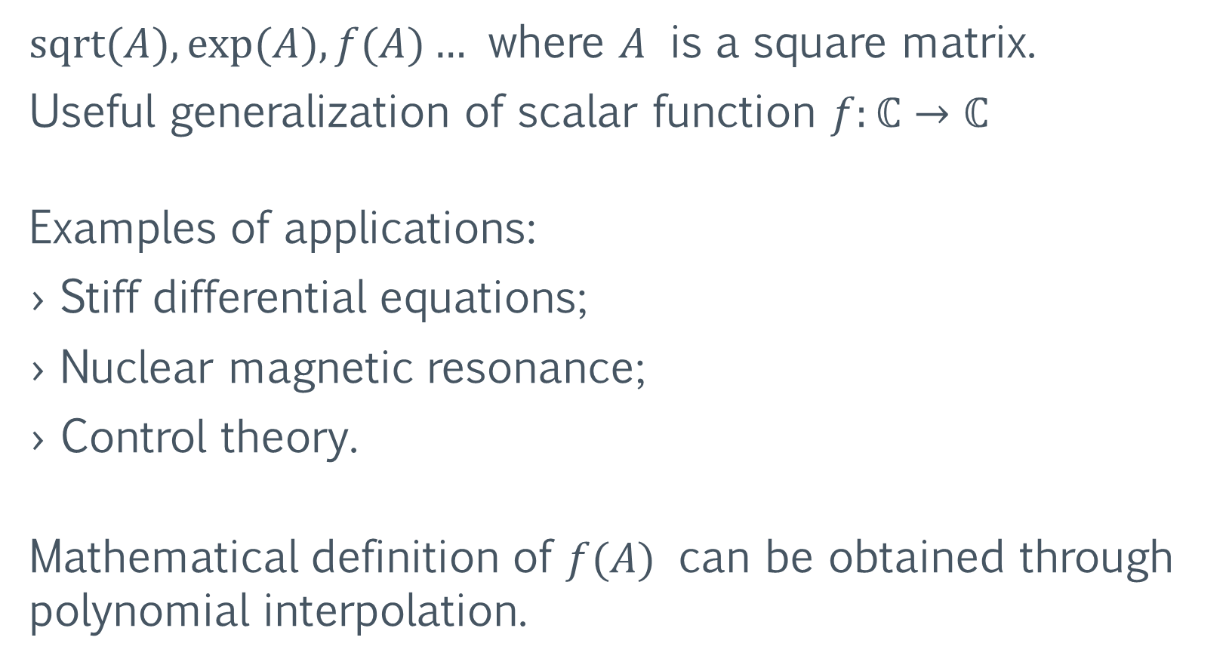
Matrix Functions
$sqrt⁡(A), exp⁡(A), f(A)…$ where $A$ is a square matrix.
Useful generalization of scalar function $f:ℂ→ℂ$
Examples of applications:
Stiff differential equations;
Nuclear magnetic resonance;
Control theory.
Mathematical definition of $f(A)$ can be obtained through polynomial interpolation.

Slide 3
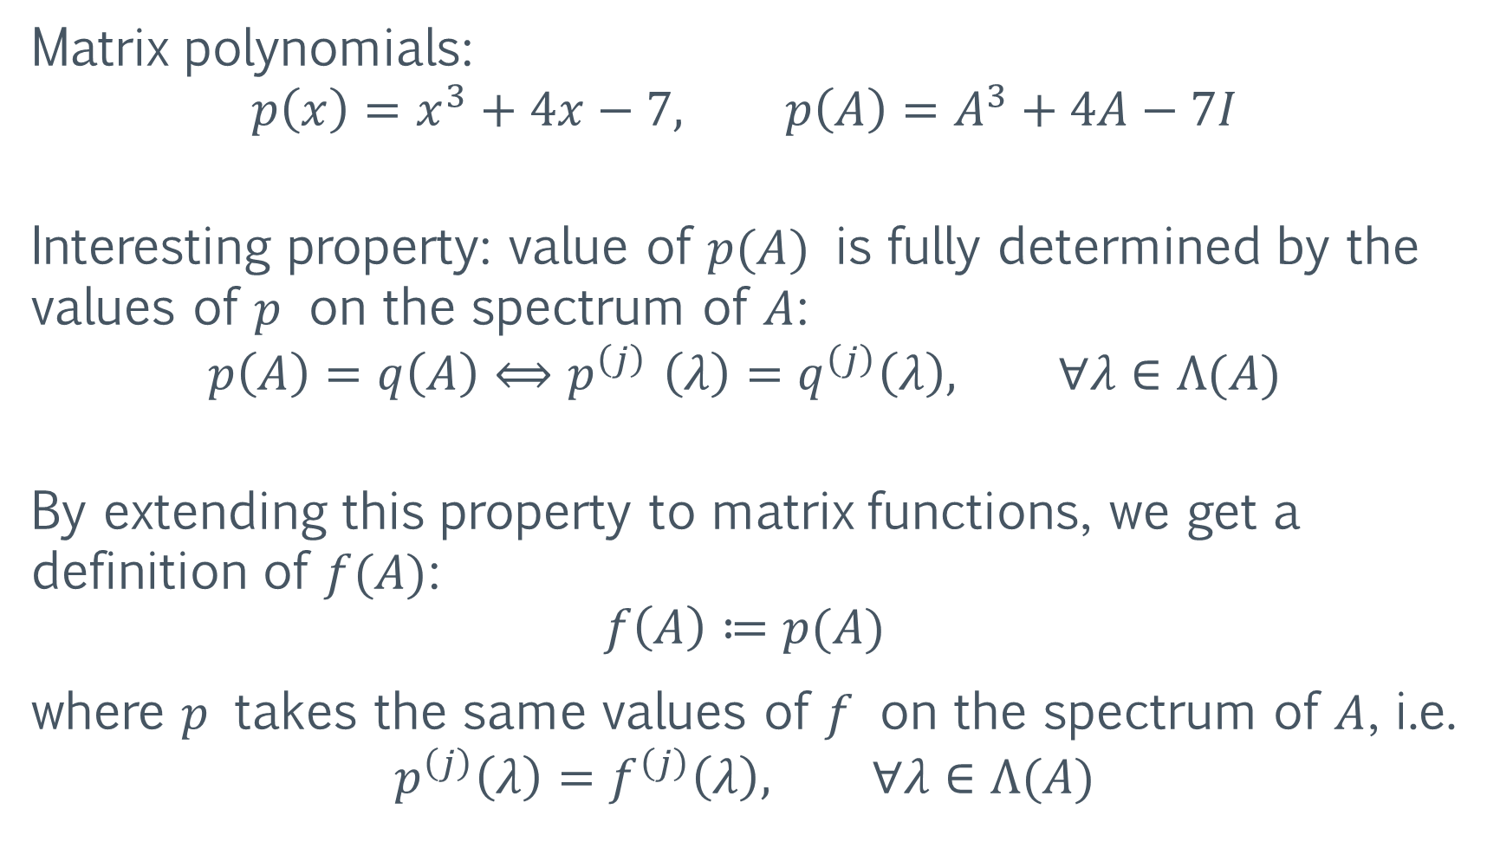
Matrix polynomials:
$$p\left(x\right)=x^{3}+4x−7, p\left(A\right)=A^{3}+4A−7I$$
Interesting property: value of $p(A)$ is fully determined by the values of $p$ on the spectrum of $A$:
$$p\left(A\right)=q\left(A\right){⟺p}^{\left(j\right)}\left(λ\right)=q^{\left(j\right)}\left(λ\right), ∀λ∈Λ(A)$$
By extending this property to matrix functions, we get a definition of $f(A)$:
$$f\left(A\right)≔p(A)$$
where $p$ takes the same values of $f$ on the spectrum of $A$, i.e.
$$p^{\left(j\right)}\left(λ\right)=f^{\left(j\right)}\left(λ\right), ∀λ∈Λ(A)$$

Slide 4
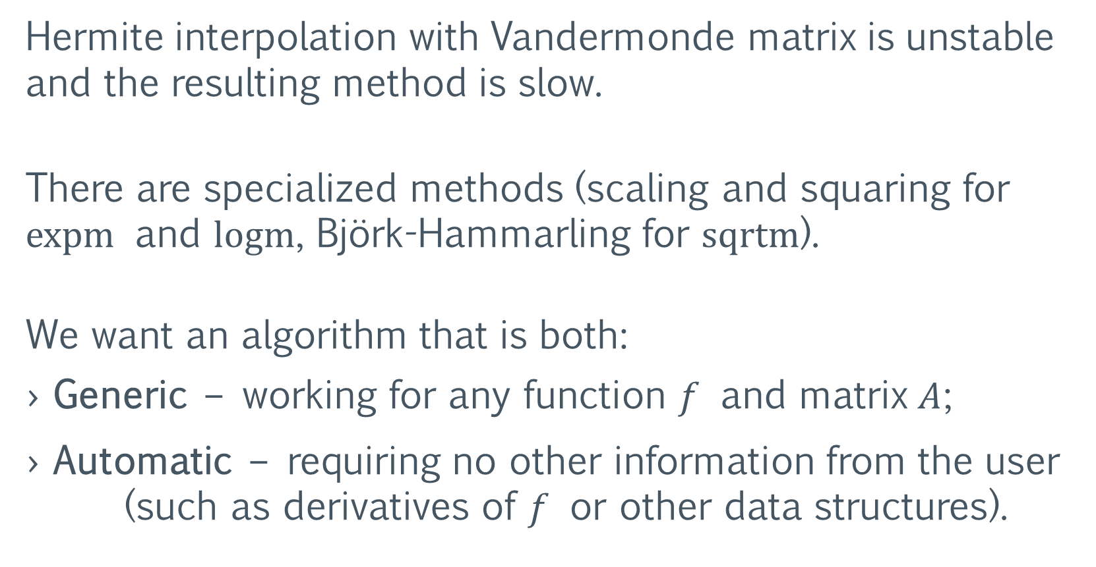
Computation of Matrix Functions
Hermite interpolation with Vandermonde matrix is unstable and the resulting method is slow.
There are specialized methods (scaling and squaring for expm and logm, Björk-Hammarling for sqrtm).
We want an algorithm that is both:
Generic – working for any function $f$ and matrix $A$;
Automatic – requiring no other information from the user (such as derivatives of $f$ or other data structures).

Slide 5
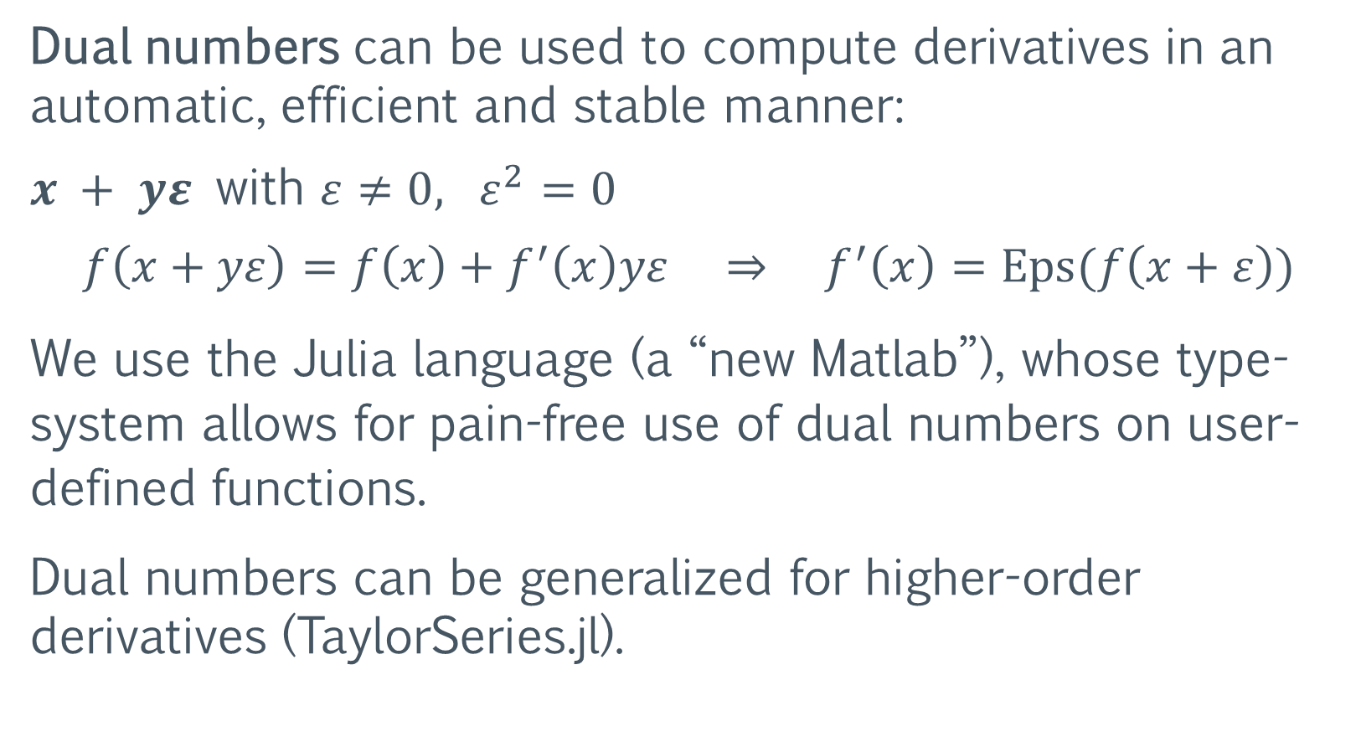
Automatic Differentiation
Dual numbers can be used to compute derivatives in an automatic, efficient and stable manner:
$x + yε$ with $ε≠0, ε^{2}=0$
$$f\left(x+yε\right)=f\left(x\right)+f^{′}\left(x\right)yε ⇒ f^{′}\left(x\right)=Eps(f\left(x+ε\right))$$
We use the Julia language (a “new Matlab”), whose type-system allows for pain-free use of dual numbers on user-defined functions.
Dual numbers can be generalized for higher-order derivatives (TaylorSeries.jl).

Slide 6
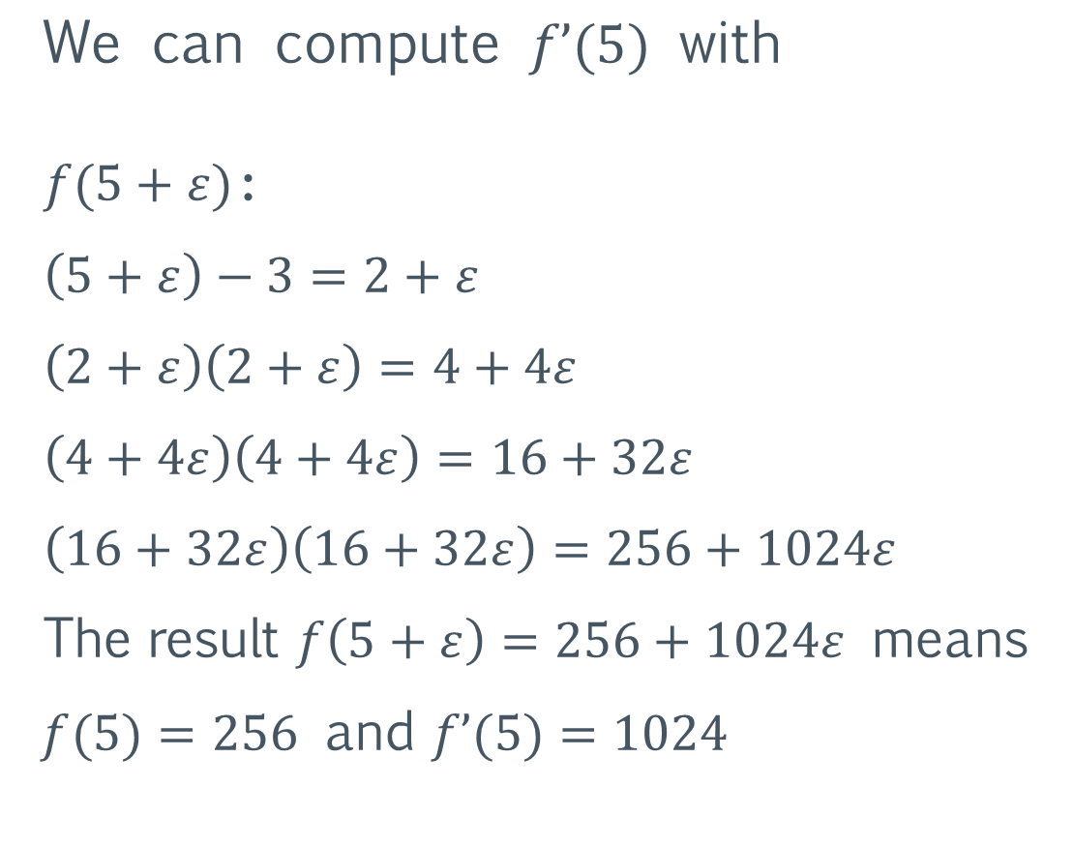

Automatic Differentiation – example
$$f(x) ={(x−3)}^{8}$$
function f(x)
x -= 3
for i = 1:3
x *= x
end
return x
end
$$\text{We} \text{can} \text{compute} f’(5) \text{with}$$
$f(5+ε)$:
$\left(5+ε\right)−3=2+ε$
$\left(2+ε\right)\left(2+ε\right)=4+4ε$
$\left(4+4ε\right)\left(4+4ε\right)=16+32ε$
$\left(16+32ε\right)\left(16+32ε\right)=256+1024ε$
The result $f\left(5+ε\right)=256+1024ε$ means
$f(5)=256$ and $f’(5)=1024$

Slide 7
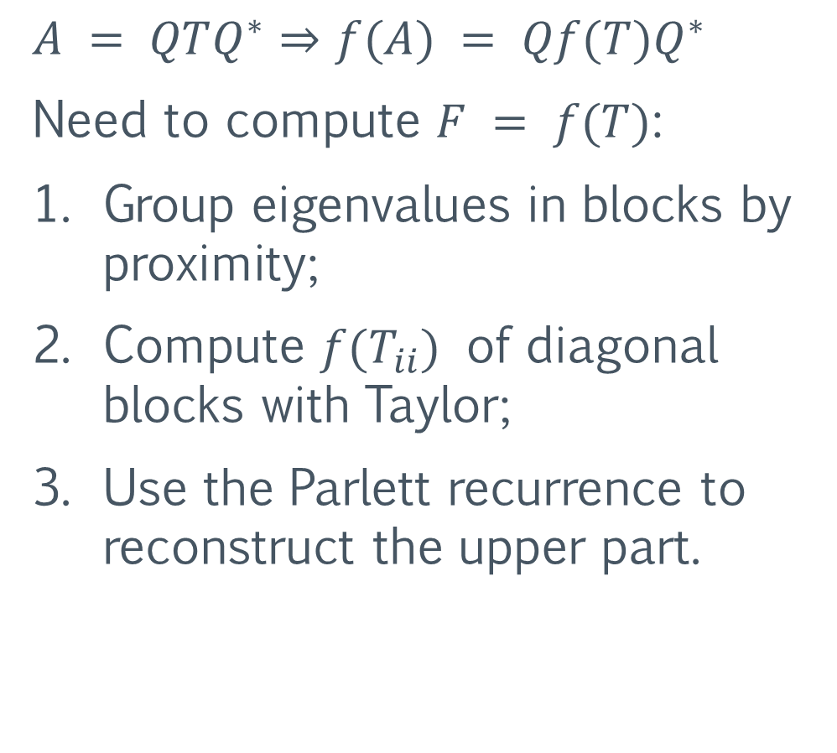

Schur-Parlett – dense matrix functions
Proposed by $\text{Higham} \text{and} \text{Davies} \text{in}\text{ 2003.}$
$$A = QTQ^{∗}⇒f(A) = Qf(T)Q^{∗}$$
Need to compute $F = f(T)$:
Group eigenvalues in blocks by proximity;
Compute $f(T_{ii})$ of diagonal blocks with Taylor;
Use the Parlett recurrence to reconstruct the upper part.

Slide 8

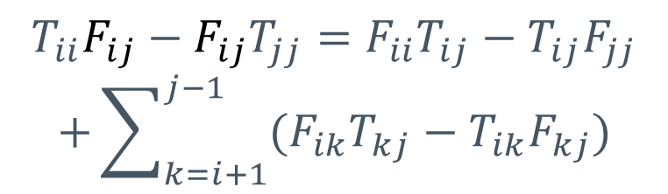
Schur-Parlett – Parlett recurrence
Parlett recurrence made recursive and cache-oblivious.
$$⇒$$
$$T_{ii}F_{ij}−F_{ij}T_{jj}=F_{ii}T_{ij}−T_{ij}F_{jj}$$
$$+\sum_{k=i+1}^{j−1}{(F_{ik}T_{kj}−T_{ik}F_{kj})}$$
$$T_{11}F_{12}−F_{12}T_{22}=F_{11}T_{12}−T_{12}F_{22}$$
~3x speedup for n = 2500

Slide 9

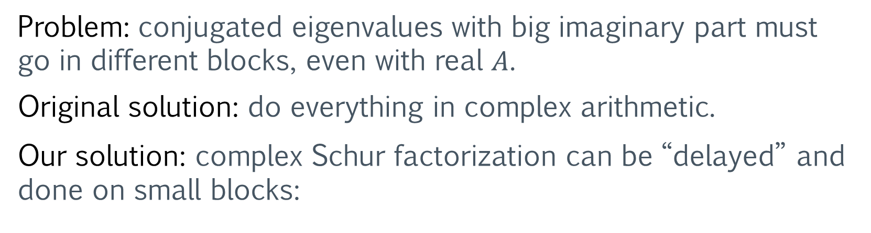

Problem: conjugated eigenvalues with big imaginary part must go in different blocks, even with real $A$.
Original solution: do everything in complex arithmetic.
Our solution: complex Schur factorization can be “delayed” and done on small blocks:
small
complex
Schur
real
Schur
$$⇒$$
$$⇒$$
Also allows for Parlett recurrence in real arithmetic, ~2x speedup for n = 2500 on whole Schur-Parlett.

Slide 10

Schur-Parlett – performance results
The whole procedure typically spends ~2/3 of the time doing $A$’s Schur decomposition (varies depending on the eigenvalues’ distribution).

Slide 11
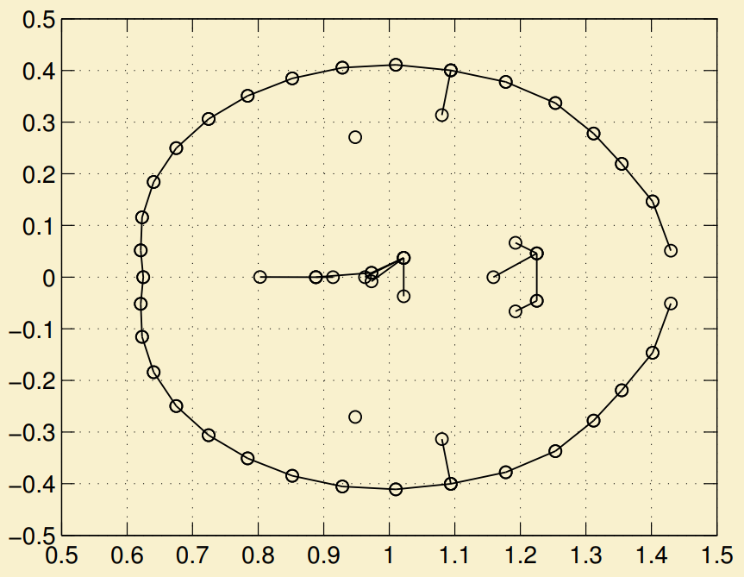
Schur-Parlett – numerical accuracy
 | Specialized method | Schur-Parlett
exp | 1.0e-14 | 1.5e-13
log | 4.0e-14 | 4.1e-14
sqrt | 4.3e-14 | 4.5e-14
Relative error versus Matlab’s Symbolic Toolbox (on 50x50 random matrix).
Boils down to how well the eigenvalues can be clustered.
Can behave badly (7e-4) with “snake” eigenvalues (as shown in original paper, experiment 4)

Slide 12
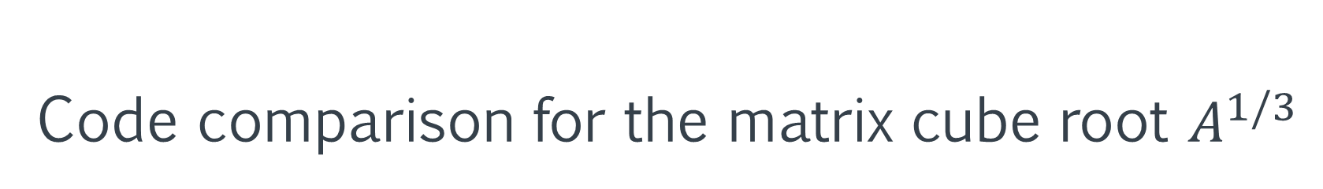
Code comparison for the matrix cube root $A^{1/3}$
Matlab
Our Julia implementation
function r = cuberoot(x, k)
c = 1.0;
for i = 0:k-1
c = c*(1/3 – i);
end
r = c*x^(1/3 - k);
end
funm(A, @cuberoot)
schurparlett((x)->x^(1/3), A)

Slide 13
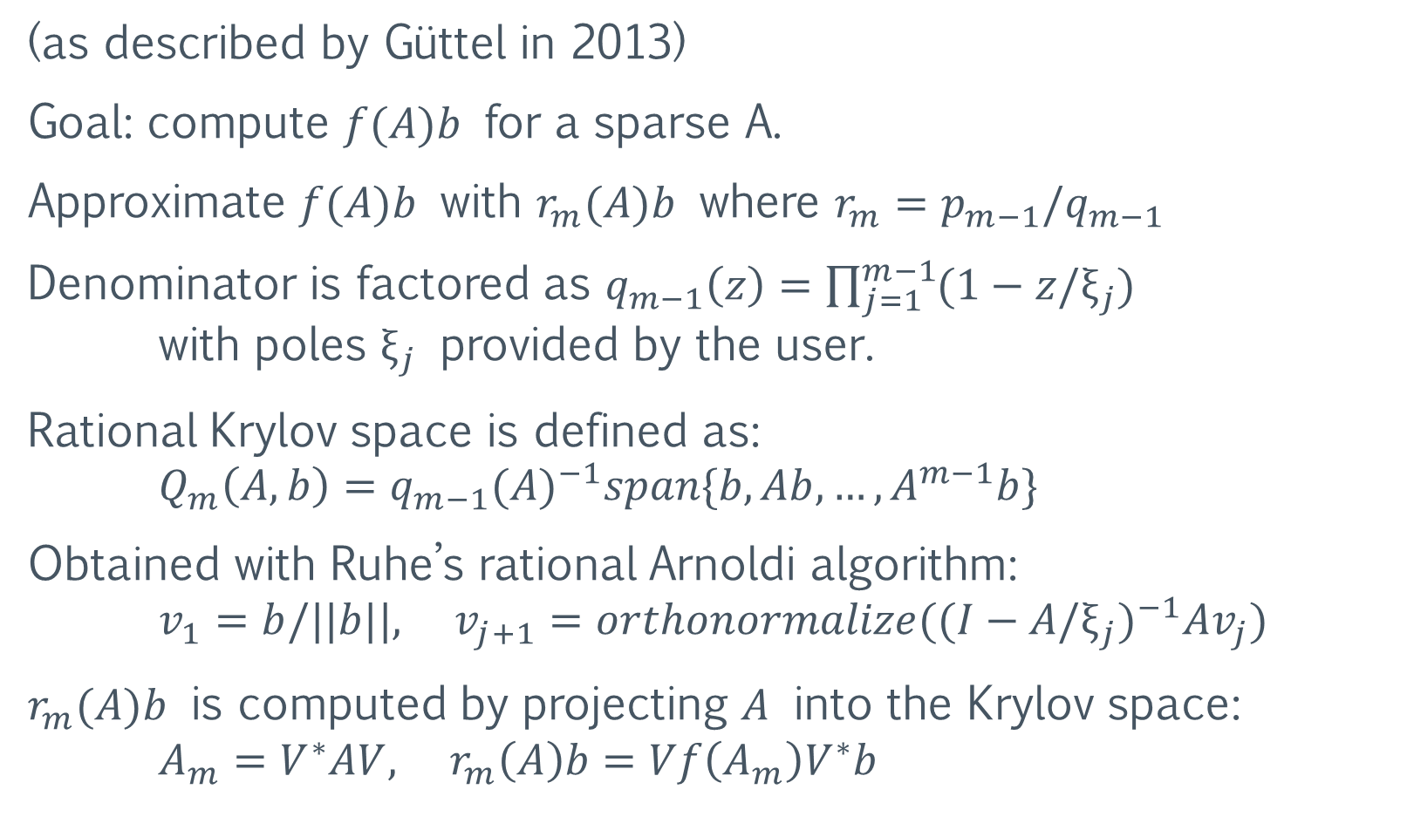
Rational Krylov – sparse matrix functions
(as described by Güttel in 2013)
Goal: compute $f(A)b$ for a sparse A.
Approximate $f(A)b$ with $r_{m}(A)b$ where $r_{m}=p_{m−1}/q_{m−1}$
Denominator is factored as $q_{m−1}\left(z\right)=\prod_{j=1}^{m−1}{(1−z/ξ_{j})}$ with poles $ξ_{j}$ provided by the user.
Rational Krylov space is defined as: $Q_{m}\left(A, b\right)=q_{m−1}{(A)}^{−1}span\{b, Ab,…,A^{m−1}b\}$
Obtained with Ruhe’s rational Arnoldi algorithm: $v_{1}=b/||b||, v_{j+1}=orthonormalize({(I−A/ξ_{j})}^{−1}Av_{j})$
$r_{m}(A)b$ is computed by projecting $A$ into the Krylov space: $A_{m}=V^{∗}AV, r_{m}\left(A\right)b=Vf\left(A_{m}\right)V^{∗}b$

Slide 14
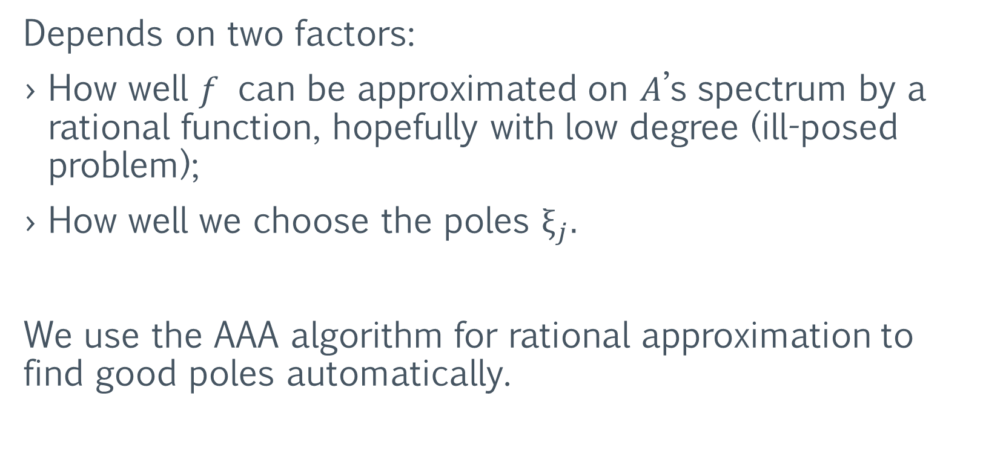
Rational Krylov – approximation accuracy
Depends on two factors:
How well $f$ can be approximated on $A$’s spectrum by a rational function, hopefully with low degree (ill-posed problem);
How well we choose the poles $ξ_{j}.$
We use the AAA algorithm for rational approximation to find good poles automatically.

Slide 15
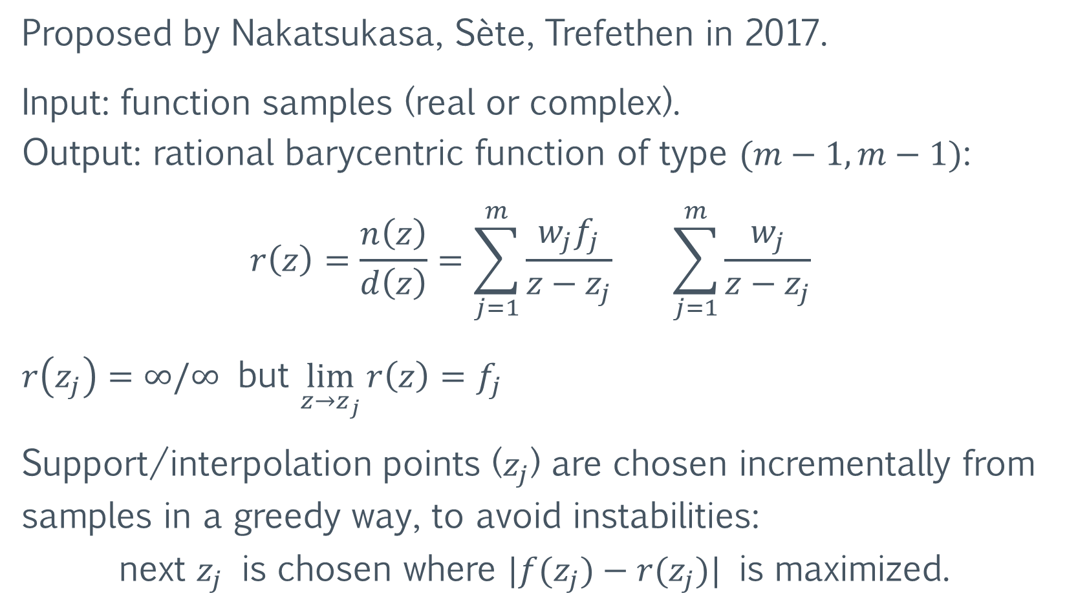
AAA algorithm for rational approximation
Proposed by Nakatsukasa, Sète, Trefethen in 2017.
Input: function samples (real or complex). Output: rational barycentric function of type $(m−1, m−1)$:
$$r\left(z\right)=\frac{n\left(z\right)}{d\left(z\right)}=\sum_{j=1}^{m}{\frac{w_{j}f_{j}}{z−z_{j}}} \sum_{j=1}^{m}{\frac{w_{j}}{z−z_{j}}}$$
$r\left(z_{j}\right)=∞/∞$ but $\lim_{z→z_{j}}{r\left(z\right)}=f_{j}$
Support/interpolation points ($z_{j}$) are chosen incrementally from samples in a greedy way, to avoid instabilities: next $z_{j}$ is chosen where $|f(z_{j})−r(z_{j})|$ is maximized.

Slide 16
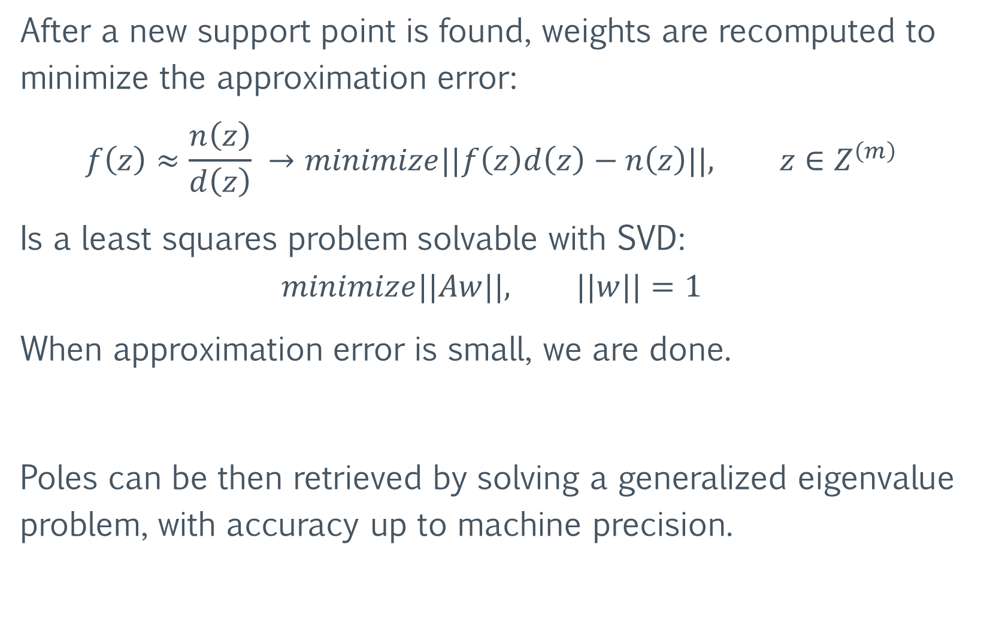
After a new support point is found, weights are recomputed to minimize the approximation error:
$$f\left(z\right)≈\frac{n\left(z\right)}{d\left(z\right)} →minimize||f\left(z\right)d\left(z\right)−n\left(z\right)||, z∈Z^{\left(m\right)}$$
Is a least squares problem solvable with SVD:
$$minimize||Aw||, ||w||=1$$
When approximation error is small, we are done.
Poles can be then retrieved by solving a generalized eigenvalue problem, with accuracy up to machine precision.

Slide 17
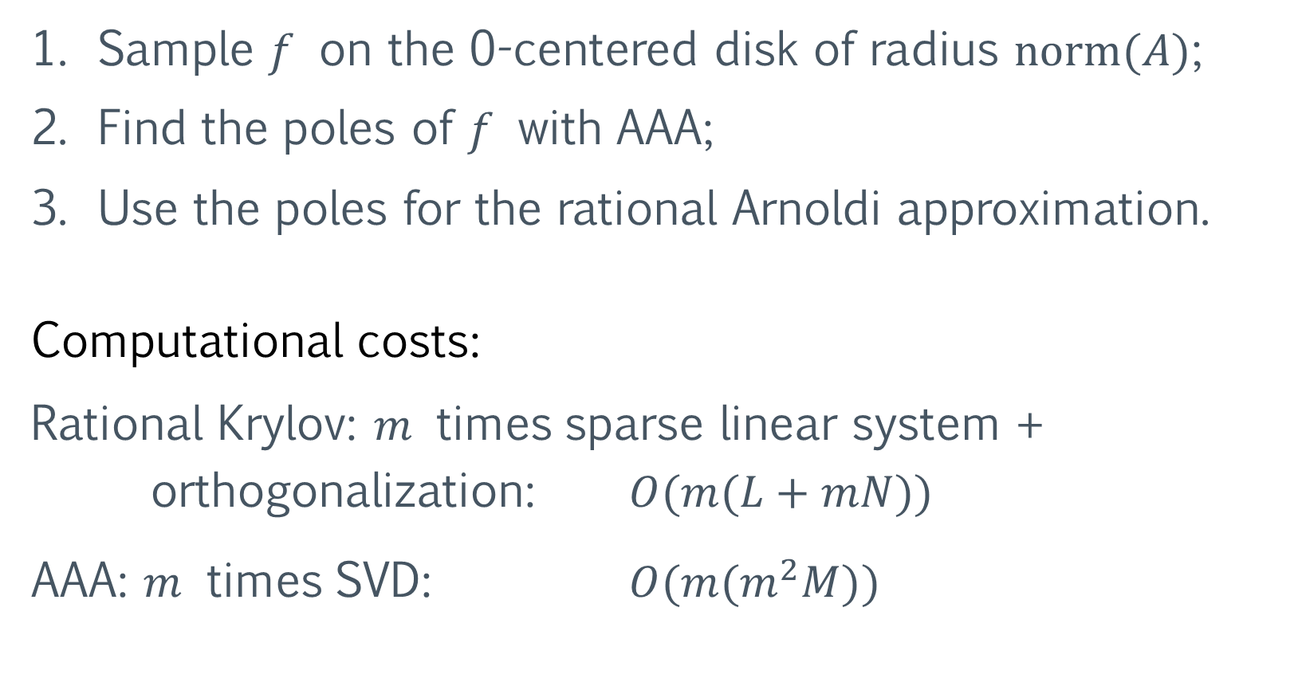
Rational Krylov + AAA
Sample $f$ on the 0-centered disk of radius $norm(A)$;
Find the poles of $f$ with AAA;
Use the poles for the rational Arnoldi approximation.
Computational costs:
Rational Krylov: $m$ times sparse linear system + orthogonalization: $O(m(L+mN))$
AAA: $m$ times SVD: $O(m(m^{2}M))$

Slide 18

Rational Krylov + AAA, Experiment 1
Matrices are from the SuiteSparse Matrix Collection. $exp⁡(A)b$ with Krylov is compared with dense $expm$:
Problem type | name | cond(A) | cond (exp, A) | # poles | error | # poles | error
2D/3D problem | jagmesh3 | 1168 | 7.0e0 | 9 | 1.5e-6 | 15 | 6.0e-14
Fluid dynamics | sherman4 | 2178 | 1.2e2 | 11 | 6.6e-6 | 19 | 6.7e-10
Structural problem | can_1072 | 2.0e34 | 3.4e1 | 11 | 7.3e-6 | 23 | 1.7e-14
Directed graph | SmaGri | Inf | 7.8e1 | 9 | 2.6e-7 | 21 | 7.3e-13

Slide 19
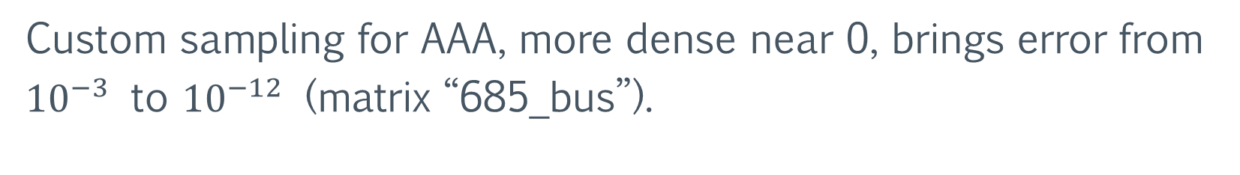
Rational Krylov + AAA, Experiment 2
$sqrt⁡(A)b$ (positive definite $A$) against dense $sqrtm$:
Problem type | name | min eig(A) | norm(A) | # poles | error | # poles | error
Circuit simulatio | rajat19 | 1.7e-1 | 3.9e1 | 20 | 5.8e-6 | 45 | 3.7e-14
Structural problem | nos3 | 1.8e-2 | 7.7e2 | 50 | 8.8e-4 | 100 | 5.2e-9
Power network | 685_bus | 6.2e-2 | 2.6e4 | 50 | 1.5e-3 | 95 | 8.0e-5
Electro magnetic | mhd 1280b | 1.5e-11 | 8.0e1 | 50 | 2.5e-2 | 50 | 8.8e-3
Custom sampling for AAA, more dense near 0, brings error from ${10}^{−3}$ to ${10}^{−12}$ (matrix “685_bus”).

Slide 20
Future Work
Different algorithms could be used for the evaluation of the diagonal blocks in Schur-Parlett (replacing Taylor).
An AAA solution could solve some of Schur-Parlett’s instability issues and lift the dependency on automatic differentiation, bringing the automatic algorithm to other languages such as Matlab and C (more research needed).

Slide 21
Try it out at:
https://github.com/robzan8/MatFun.jl
Questions?

